Slide 1

Space invaders game

Slide 2
Name : patel Tirth rajeshkumar
Batch : A5
Roll No : 164
Enrollment No :2021002170110119

Slide 3
Introduction
The objective of Space Invaders, which was one of the earliest video games released, is to pan across a screen and shoot descending swarms of aliens, preventing them from reaching the bottom of the screen. It is viewed as a pioneer of modern gaming.

Slide 4
Space Invaders game guidelines :
The aliens should move toward the bottom once some time has passed.
The game should stop when the aliens touch the bottom edge.
The only possible directions for the player's ship to go are left or right.
A score counter should be included. If we hit the alien, players get an point.

Slide 5
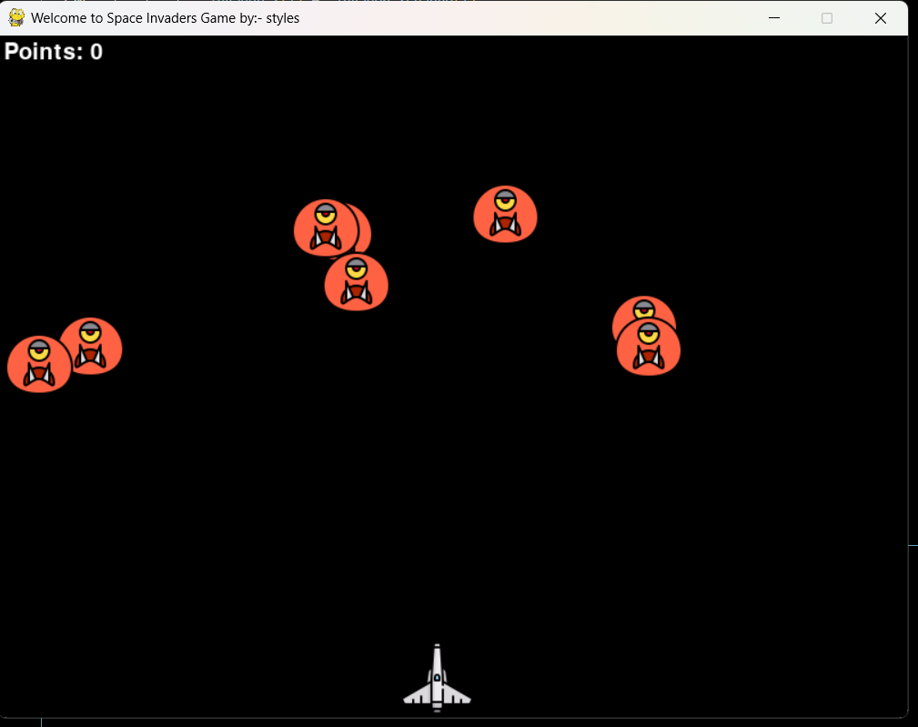
Output :

Slide 6
Thank you

